Slide 1
MVC Crash Course with FW/1
Steven Neiland

Slide 2
MVC – Model View Controller
Is a pattern not a technology
Common in frameworks
Does *not* require a framework
Can be used with other patterns

Slide 3
Benefits
Separation of concerns
Cleaner code
Improved testability
Parallel development
Portability

Slide 4
MVC Components - Controller
The Controller acts like a “good” project manager. Delegating tasks to individual services within the model and passing the returned data to a particular View for output.
The Controller does not know how the model does what it does, only that for a given task it calls a certain service in the model that requires x & y and returns a value z.
Once the value z is returned from the Model, the controller then passes this value to the View for output.

Slide 5
MVC Components - Model
The Model can be thought of like a programming department, where each programmer represents a specialized Service.
When an individual programmer (Service) gets a request from the manager (Controller) to perform a task it goes away and does what it needs to do.
The programmer (Service) can call upon other programmers to perform specific specialized operations, or pull data from stored records (database/session) to help it complete its task.
Once the task is performed that Service returns a result to the Controller.
Service has no knowledge about how that result will be used.

Slide 6
MVC Components - View
The View is the dumb part of the application.
It has no knowledge of business logic, structure or other views.
All the view knows is that the Controller will give it some data which it always displays in a given way.

Slide 7
Url / Form Variables
Controller
Model
Page Request
View

Slide 8
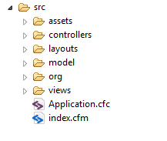
FW/1 Structure
(or “services” explanation to follow)

Slide 9
FW/1 Action By Convention
index.cfm?action={section}.{item}
  Controller
    /controllers/{section}.cfc method={item}
  View
    /views/{section}/{item}.cfm
  Layout
    /layouts/{section}/{item}.cfm
    /layouts/{section}.cfm
    /layouts/default.cfm – (unless overridden)

Slide 10
Controller

Slide 11
Controller – Core Logic
This is the core code of the system. Normally the framework code itself.
It has no knowledge of what views or services exists.
We do not modify the core logic code. For all intents it is a black box.
Controller reads and operates from a set of command/config files.

Slide 12
Controller – Instruction files
These define the operations the controller needs to follow for a given action.
Defines what services and views exist.
Defines associations between model and views. *Not business logic*
Often defined as xml files, but can be anything.
  Fusebox 3 as fbx_switch
  FW/1 as cfcs.

Slide 13



Controller
Model
Core Logic
Config
Config
Page Request
Config
View

Slide 14
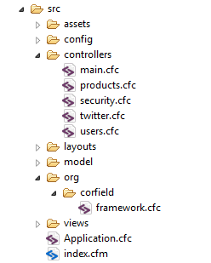
Controller In FW/1
Controller Configuration
Framework Core
Framework Extension
& Global Config

Slide 15
Structure Of A Controller.cfc
Init()
  Required, optionally setup reference to helper functions
Before()
  Optional, runs before all item specific methods
startItem()
  Runs before the item() method if defined

Slide 16
Structure Of A Controller.cfc
Item()
  The section.item action method
endItem()
  Runs after item() if defined
After()
  Runs after all item specific methods

Slide 17
Model / Services

Slide 18
Model - Services
The main business logic
  Data transformation
  Computational logic
Communicates with other services, gateways and state systems
Controller communicates with Services

Slide 19
Model - Gateways
A dumb service
Responsible for sending / retrieving data
  Acts as a communication transform with other systems
Does not maintain state (beyond initialization)
Responds to requests, does not make them
Does not talk to other services or gateways (in the app)

Slide 20
Url / Form Variables
Model
Controller
Service A
State
Service B
Gateway 1
Page
Request
Service C
Gateway 2
Service D
View

Slide 21
Model In FW/1
Two Different Options
  Use FW/1’s implicit Service Creation
    Very easy to setup
    Turned off by default in v2.0
    Less friendly to use in my opinion
  Use a 3rd party dependency injection framework like ColdSpring or DI/1
    Requires a little more work to setup
    More flexible

Slide 22
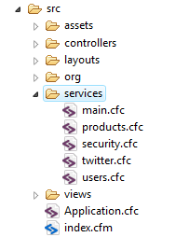
Implicit Services In FW/1

Slide 23
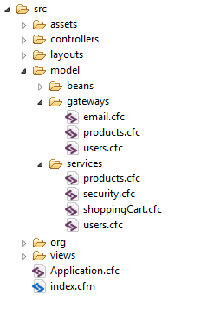
My Model Structure In FW/1

Slide 24
View

Slide 25
View - Sections
An action specific view
Transforms data into output
Does not know where or how data was generated just that it has been given it.

Slide 26
View - Layout
More a web orientated concept (in a desktop app would be the window container)
Basically the site layout wrapper
Section specific view feed into it.
The main layout wraps the section view. Set from the controller.

Slide 27

Url / Form Variables
Controller
Model
Page
Request
Left Col
Right Col
View
Layout

Slide 28
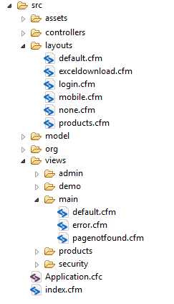
View FW/1
Section Specific Layout

Slide 29
Putting It All Together

Slide 30




Url / Form Variables
Model
Controller
Service A
State
Core Logic
Config
Service B
Gateway 1
Page
Request
Config
Service C
Config
Gateway 2
Service D
Left Col
Right Col
View
Main Layout

Slide 31
FW/1 Conventions
Form and URL variables get merged into RC
index.cfm?action={section}.{item}
  Controller
    /controllers/{section}.cfc method={item}
  View
    /views/{section}/{item}.cfm
  Layout
    /layouts/{section}/{item}.cfm
    /layouts/{section}.cfm
    /layouts/default.cfm – (unless overridden)

Slide 32
Commonly Used Functions
buildUrl(action,queryString)
setlayout(“section.item”)
setView(“section.item”)
redirect(“section.action”[optional args])
controller(“components.method”)
service(“servicename.method”,”saveVariable”,argumentsStruct)

Slide 33
AJAX
MVC is concerned with rendering content.
Content Requests vs Data Requests
  Brian Kotek
Four options
  Manually create a proxy
  Use coldspring to autowire a proxy
  Leverage onMissingView()
  Leverage onCFCRequest()

Slide 34
Lets Look At Some Code

Slide 35
Rules
Every call from the Controller to the Model should return a value that gets sent to the View.
Once data has been passed from the model to the controller is should be considered immutable.
The Controller does not contain business logic.
The Model contains business logic and data. It is unaware of the Controller and Views.
Views can only receive data, they cannot send or request data.

Slide 36
Kiss
MVC can be as simple as you want or as complex as you need.
Refactor refactor refactor
Download & Wiki:
  https://github.com/seancorfield/fw1/

